Slide 1
Deploy &configure storage

Slide 2
Introduction to Terraform
Terraform is an open-source infrastructure as code (IaC) tool developed by HashiCorp.
It enables you to define and provision infrastructure in a declarative configuration language called HCL (HashiCorp Configuration Language).
With Terraform, you can manage resources across multiple cloud providers, such as AWS, Azure, Google Cloud, and even on-premises data centers.
It allows you to define your infrastructure, automate its provisioning, and manage it in a consistent and repeatable way.
Key Concepts
Infrastructure as Code (IaC): Terraform allows you to describe your infrastructure using code. This means that your infrastructure can be versioned, stored in source control, and treated like any other software project.
Declarative Syntax: Terraform uses a declarative approach to define infrastructure. You describe what you want, and Terraform determines how to create and manage the infrastructure for you.

Slide 3
State Management: Terraform keeps track of the infrastructure it manages using a state file, typically stored in a local or remote backend. This file represents the "current" state of your infrastructure, which Terraform uses to compare against the desired state defined in your configuration files.
Execution Plan: When you run Terraform, it creates an execution plan that shows you what actions it will take (e.g., creating, updating, or deleting resources). This plan is shown to you before any changes are made, ensuring transparency and safety in changes.
Providers: Terraform uses providers to interact with APIs of various services (e.g., AWS, Azure, Google Cloud, etc.). Each provider is responsible for managing resources within its own cloud ecosystem.
Resources: A resource is a component of your infrastructure, such as an EC2 instance, an S3 bucket, or a security group. Terraform uses the resource type and configuration to define these components in your infrastructure.
Modules: Modules are reusable collections of Terraform configuration files that can be used to simplify complex infrastructure setups. They allow you to create more maintainable and modular infrastructure code.

Slide 4
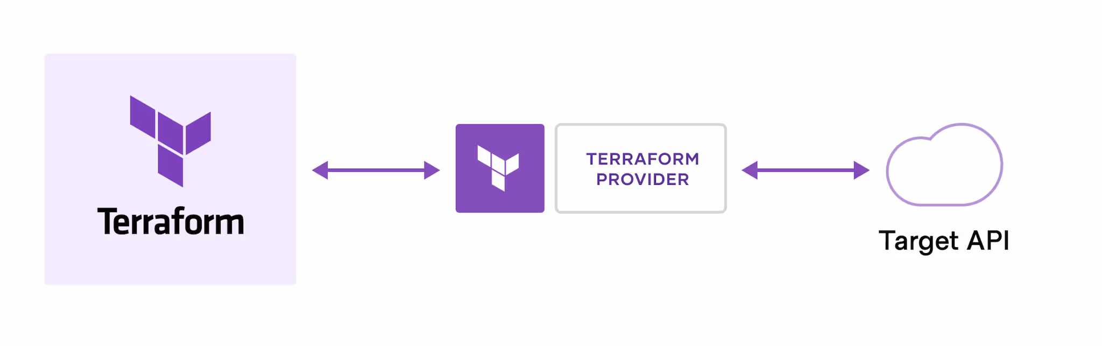
How does Terraform work?
Terraform creates and manages resources on cloud platforms and other services through their application programming interfaces (APIs). Providers enable Terraform to work with virtually any platform or service with an accessible API.

Slide 5
Basic Workflow:
The typical Terraform workflow involves the following steps:
Write Configuration:
Write Terraform configuration files in .tf files, defining the resources you want to create.
Initialize Terraform:
Run terraform init to initialize the working directory containing the Terraform configuration files. This will download the necessary provider plugins.
Plan Infrastructure Changes:
Run terraform plan to generate an execution plan, showing what Terraform will do (create, modify, or destroy resources) to match your configuration.
Apply Changes:
Run terraform apply to apply the changes and provision the defined infrastructure.
Destroy Infrastructure:
When no longer needed, you can use terraform destroy to tear down and remove the infrastructure managed by Terraform.

Slide 6
Introduction to AWS S3 (Amazon Simple Storage Service)
Amazon S3 (Simple Storage Service) is a scalable, high-performance cloud storage service offered by Amazon Web Services (AWS). It provides object storage, which means it stores data as objects rather than files or blocks. AWS S3 is designed for storing large amounts of data, and it is commonly used for backup, archiving, content distribution, data storage for websites and applications, and more.
Key Features of AWS S3:
Scalability:
AWS S3 is highly scalable and allows you to store an unlimited amount of data. It automatically scales to handle growing amounts of data without any manual intervention.
Durability:
S3 offers 99.999999999% (11 9s) durability. This is achieved through data replication across multiple facilities, ensuring that data is never lost.
Availability:
S3 provides high availability with multiple storage classes designed for different use cases, such as Standard, Intelligent-Tiering, One Zone-IA, and Glacier, each offering varying levels of availability.
Versioning:
S3 supports versioning, which allows you to keep multiple versions of an object in a bucket. This helps prevent accidental data loss or overwriting of objects.

Slide 7
Basic Operations with AWS S3:
Buckets:
A bucket is the fundamental container in S3 that holds objects. Each bucket must have a globally unique name.
Objects:
An object is a file stored in S3. Each object consists of the data itself, metadata, and a unique identifier (called a key).
Uploading and Downloading Objects:
You can upload or download files using the AWS Management Console, AWS CLI, SDKs, or REST API.
Managing Permissions:
You can set permissions on your S3 resources using IAM roles or policies to control access to your buckets and objects.
Data Retrieval:
S3 allows quick data retrieval, with options to retrieve data instantly (Standard) or over time with lower cost (Glacier).
Logging and Monitoring:
AWS S3 integrates with Amazon CloudWatch and AWS CloudTrail, which allows you to monitor bucket access and usage, ensuring compliance and security.

Slide 8
Introduction to AWS VPC (Virtual Private Cloud)
Amazon Web Services (AWS) Virtual Private Cloud (VPC) is a service that allows you to create a logically isolated network within the AWS cloud, where you can launch and manage AWS resources in a secure and controlled environment. It provides a private network within the AWS infrastructure, giving you full control over your virtual networking environment, including aspects like IP address range, subnets, route tables, and network gateways.
AWS VPC is essential for users who want to have secure, isolated environments within the cloud to run applications or host services, while maintaining control over networking aspects such as security, traffic routing, and connectivity to on-premises data centers.
Key Features of AWS VPC:
Subnets:
VPCs are divided into subnets, which allow you to organize resources based on their function or security requirements.Subnets can be public (accessible from the internet) or private (isolated from the internet), and you can set up separate subnets for different tiers, such as application, database, and web layers.
Route Tables:
Route tables define how traffic is directed between subnets within the VPC or between the VPC and external networks (like the internet or on-premises networks).
You can customize routing to control traffic flow, like directing traffic from a public subnet to the internet or allowing private subnets to communicate with resources in other subnets.

Slide 9
Internet Gateway (IGW):
An Internet Gateway allows instances within a public subnet to connect to the internet, enabling external access for services or applications hosted on AWS.It facilitates bidirectional communication between your VPC and the internet.
NAT Gateway and NAT Instances:
For private subnets that need to access the internet (for example, for software updates), a Network Address Translation (NAT) Gateway or NAT Instance can be set up in a public subnet.These allow resources in private subnets to send traffic to the internet without exposing them directly.
Components of AWS VPC:
VPC: The overall isolated network environment.
Subnets: Divisions within the VPC that segregate resources for organizational and security purposes.
Internet Gateway (IGW): A gateway to enable internet access for resources in public subnets.
NAT Gateway/Instance: Allows internet access from private subnets.
Route Tables: Determine how traffic flows between subnets, VPCs, and external networks.
Security Groups and NACLs: Provide security for network traffic to and from resources.
Peering Connections: Allow VPCs to communicate with each other.

Slide 10
Introduction to AWS Security Groups
In Amazon Web Services (AWS), Security Groups are virtual firewalls that control inbound and outbound traffic to AWS resources such as EC2 instances, databases, and other services. They play a critical role in securing cloud resources by defining what network traffic is allowed or denied to reach those resources.
Security Groups operate at the instance level and are associated with network interfaces of resources (such as EC2 instances) within a Virtual Private Cloud (VPC). They are used to control access based on IP address, port, and protocol type, allowing you to protect your resources from unauthorized access.
Key Features of AWS Security Groups:
Stateful:
Security Groups are stateful, meaning if you allow an incoming request, the response is automatically allowed, regardless of outbound rules. For example, if you allow an inbound connection on port 80 (HTTP), the return traffic is automatically allowed without needing to define a specific outbound rule for it.
Inbound and Outbound Rules:
You can define both inbound (incoming) and outbound (outgoing) traffic rules.
Inbound rules specify what traffic is allowed to reach your resources (e.g., HTTP requests to a web server).
Outbound rules define the traffic that can leave your resources (e.g., responses to the client’s request or communication with another server).

Slide 11
Introduction to AWS EC2 (Elastic Compute Cloud)
Amazon Elastic Compute Cloud (EC2) is a core component of Amazon Web Services (AWS), providing scalable, on-demand compute capacity in the cloud. EC2 allows users to run virtual machines (known as instances) on AWS infrastructure, enabling them to quickly scale applications and manage workloads without having to invest in physical hardware.
AWS EC2 offers flexibility and control over computing resources, allowing you to choose the configuration, operating system, and networking options based on your specific needs. It is widely used for hosting websites, running applications, processing large datasets, and building cloud-based infrastructures.
Key Features of AWS EC2:
Scalability:
EC2 instances can be launched or terminated at any time, allowing you to scale your compute capacity based on demand. You can scale vertically (by upgrading instance types) or horizontally (by adding more instances).
Flexible Instance Types:
EC2 offers a wide variety of instance types optimized for different use cases, such as compute-optimized, memory-optimized, storage-optimized, and GPU instances. Some common instance families include:
General Purpose: Balanced compute, memory, and networking resources (e.g., T3, M5).
Compute Optimized: For compute-intensive workloads (e.g., C5).
Memory Optimized: For memory-intensive applications (e.g., R5).
Storage Optimized: For workloads requiring high disk throughput (e.g., I3).
Accelerated Computing: For applications requiring GPU support (e.g., P4, G4 instances).

Slide 12
Pay-As-You-Go Pricing:
With EC2, you only pay for what you use. You are billed based on the number of instances and the duration they run. Pricing is flexible, allowing you to choose between different payment models:
On-Demand: Pay for compute capacity by the hour or second, with no long-term commitments.
Reserved: Commit to using EC2 instances for a one- or three-year term, in exchange for a significant discount.
Spot Instances: Purchase unused EC2 capacity at discounted prices, suitable for flexible, fault-tolerant workloads.
Savings Plans: Offers flexible pricing plans that provide savings over on-demand pricing in exchange for committing to consistent usage.
Elastic Load Balancing (ELB):
EC2 instances can be integrated with Elastic Load Balancers, which automatically distribute incoming traffic across multiple instances to ensure high availability and fault tolerance.
Auto Scaling:
EC2 integrates with Auto Scaling, a service that automatically adjusts the number of instances in response to changes in traffic or workload, ensuring optimal performance and cost-efficiency.

Slide 13
Common Use Cases for AWS EC2:
Web Hosting and Application Servers:
EC2 is often used to host websites and web applications. With its scalability, it can handle varying traffic loads by scaling up or down based on demand.
Running Databases:
EC2 can be used to run databases such as MySQL, PostgreSQL, and MongoDB. Combined with Amazon RDS, it allows users to run and scale relational databases without the management overhead.
Big Data and Analytics:
EC2 is suitable for processing large datasets, running data analytics tools like Apache Hadoop or Apache Spark, and providing computational power for data-intensive applications.
DevOps and Continuous Integration/Continuous Deployment (CI/CD):
EC2 instances are commonly used in DevOps pipelines to run test environments, build systems, and staging servers to support automated development workflows.
Machine Learning and AI:
EC2 provides GPU instances (e.g., P3, G4) for machine learning, AI model training, and other computationally intensive tasks like image or video processing.

Slide 14
Introduction of RDS (Relational Database Service):
Amazon Web Services (AWS) Relational Database Service (RDS) is a managed cloud database service that simplifies the setup, operation, and scaling of relational databases. It provides a variety of database engines, including popular options like MySQL, PostgreSQL, MariaDB, Oracle, and Microsoft SQL Server.
Key Features of AWS RDS:
Managed Service: AWS RDS automates common administrative tasks such as database provisioning, patching, backups, recovery, and scaling, so you can focus more on application development.
Multiple Database Engines: AWS RDS supports multiple relational database engines, giving you the flexibility to choose the one that best fits your application's needs.
Scalability: With RDS, you can scale your database storage and compute resources as your needs grow. You can easily increase storage and compute capacity without significant downtime.
High Availability: RDS supports Multi-AZ (Availability Zone) deployments, ensuring high availability and failover support for disaster recovery. If one instance fails, another is automatically brought online.
Automatic Backups: RDS automatically takes daily backups and retains transaction logs, so you can restore data to any point within the retention period.

Slide 15
Benefits of AWS RDS:
Simplicity:
RDS simplifies database management by automating routine tasks, such as patching and backups.
Reliability:
With built-in fault tolerance and Multi-AZ deployments, RDS offers high availability and reduces the risk of downtime.
Security:
RDS integrates with AWS security services like IAM, VPC, and KMS to ensure data privacy and secure access.
Performance:
RDS provides high-performance database instances, including options for provisioned IOPS for applications requiring low-latency and high-throughput.

Slide 16
Introduction of EBS :
Amazon Elastic Block Store (EBS) is a cloud storage service provided by Amazon Web Services (AWS) that offers scalable, high-performance block-level storage for use with Amazon EC2 (Elastic Compute Cloud) instances. EBS provides persistent storage, meaning data remains available even after the EC2 instance is stopped or terminated. It is widely used for applications that require a reliable, low-latency, and high-performance storage solution.
Key Features of Amazon EBS:
Persistent Storage: EBS volumes are independent of EC2 instances and retain data even if the instance is stopped or terminated, making them suitable for storing critical data like databases, file systems, or application data.
Block-Level Storage: EBS provides block storage, which means data is stored in fixed-size blocks. This allows for more flexibility and control over how data is read and written, making it ideal for databases and file systems.
Scalability: You can scale EBS storage as needed. Whether you need a few gigabytes or several terabytes, EBS volumes can be expanded easily. Additionally, you can increase or decrease performance by adjusting volume types or sizes.
Snapshots: EBS supports incremental backups of volumes using snapshots. These snapshots are stored in Amazon S3 and can be used to restore volumes or create new ones.

Slide 17
Benefits of Amazon EBS:
Persistence and Durability:
EBS volumes retain data even when the associated EC2 instance is stopped, ensuring your data is safe.
Scalability and Flexibility:
Easily scale storage size and performance to meet the needs of your applications.
Secure and Compliant:
EBS supports encryption at rest and in transit, meeting security and compliance requirements.
Performance:
EBS provides high-performance storage for both I/O-intensive and throughput-intensive applications.
Ease of Management:
Simple to manage, with features like snapshots for backup, cloning, and recovery.

Slide 18
Terraform configuration set up with Vpcs,Subnets,Route Tables,Internet gateway,Security groups,Ec2,S3,RDS,EBS.
Step 1 :
1.create a folder connect with visual studio code.
2. In a folder we can create a provider.tf file.
3.In the visual studio code
The provided Terraform code creates a complete infrastructure on AWS that includes a VPC, EC2 instance, S3 bucket, RDS database instance, and EBS volume. Here's a detailed step-by-step explanation of what each section of the code does:

Slide 19
provider.tf
This file defines the required provider for AWS and configures the AWS provider.
terraform {
required_providers {
aws = {
source = "hashicorp/aws"
version = "~> 5.0"
}
}
}
# Configure the AWS Provider
provider "aws" {
region = "eu-central-1"
}

Slide 20
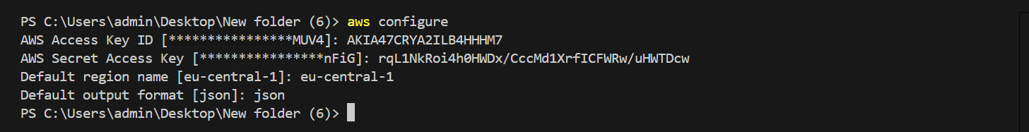
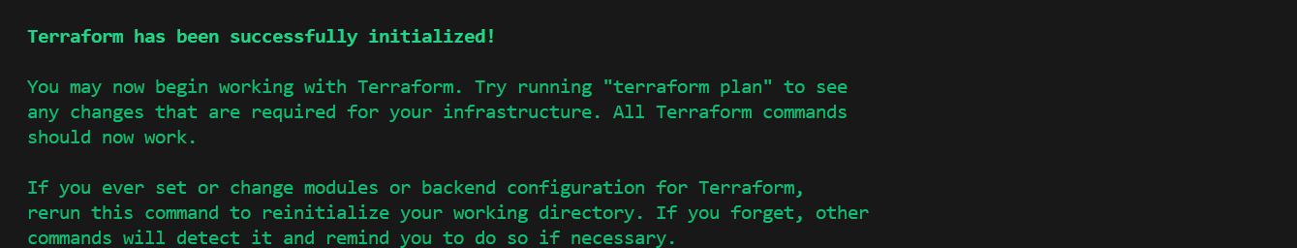
Terraform Block: Specifies the version and source of the AWS provider, in this case, version 5.0 of the AWS provider (hashicorp/aws).
Provider Block: Configures the AWS provider to use the region eu-central-1 (Frankfurt). This is where all resources will be provisioned.
After run below commands in visual studio code
Step 2: aws configure
Step 3 : terraform init
The terraform init command initializes a working directory for use with Terraform

Slide 21
main.tf
This file contains the main configuration, which includes the creation of a VPC, subnets, internet gateway, route tables, security groups, EC2 instance, S3 bucket, RDS instance, and EBS volume.
Vpc code:
resource "aws_vpc" "main" {
cidr_block = "10.0.0.0/16"
enable_dns_support = true
enable_dns_hostnames = true
tags = {
Name = "main-vpc"
}
}
Code explanation:
VPC: Creates a Virtual Private Cloud (VPC) with a CIDR block 10.0.0.0/16, which allows you to create up to 65,536 private IP addresses.
DNS Support: Enables DNS resolution and DNS hostnames within the VPC to simplify the management of instances.

Slide 22
Subnet Setup code:
resource "aws_subnet" "subnet_a" {
vpc_id = aws_vpc.main.id
cidr_block = "10.0.1.0/24"
availability_zone = "eu-central-1a"
map_public_ip_on_launch = true
tags = {
Name = "subnet-a"
}
}
resource "aws_subnet" "subnet_b" {
vpc_id = aws_vpc.main.id
cidr_block = "10.0.2.0/24"
availability_zone = "eu-central-1b"
map_public_ip_on_launch = true
tags = {
Name = "subnet-b"
}
}

Slide 23
Subnets: Two subnets are created:
Subnet A: In Availability Zone eu-central-1a with CIDR block 10.0.1.0/24.
Subnet B: In Availability Zone eu-central-1b with CIDR block 10.0.2.0/24.
Public IP Assignment: Both subnets are configured to automatically assign public IP addresses to instances launched within them.
After add internet gateway code use this:
resource "aws_internet_gateway" "main" {
vpc_id = aws_vpc.main.id
tags = {
Name = "main-igw"
}
}
Code explanation:
Internet Gateway: Creates an internet gateway (main-igw) and attaches it to the VPC. This allows resources within the VPC to communicate with the internet.

Slide 24
resource "aws_route_table" "main" {
vpc_id = aws_vpc.main.id
tags = {
Name = "main-route-table"
}
}
resource "aws_route" "internet_access" {
route_table_id = aws_route_table.main.id
destination_cidr_block = "0.0.0.0/0"
gateway_id = aws_internet_gateway.main.id
}
Route Table: Creates a route table for the VPC and defines a route (0.0.0.0/0) to the internet gateway (main-igw).
Route: This route ensures that any traffic destined for the internet is directed through the internet gateway.

Slide 25
resource "aws_route_table_association" "subnet_a_association" {
subnet_id = aws_subnet.subnet_a.id
route_table_id = aws_route_table.main.id
}
resource "aws_route_table_association" "subnet_b_association" {
subnet_id = aws_subnet.subnet_b.id
route_table_id = aws_route_table.main.id
}
Route Table Associations:
Associates the route table to the subnets, ensuring that instances in these subnets can route traffic to the internet via the internet gateway.

Slide 26
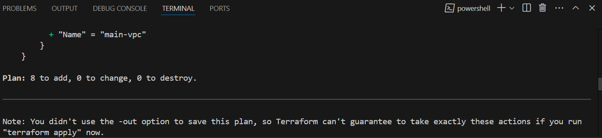
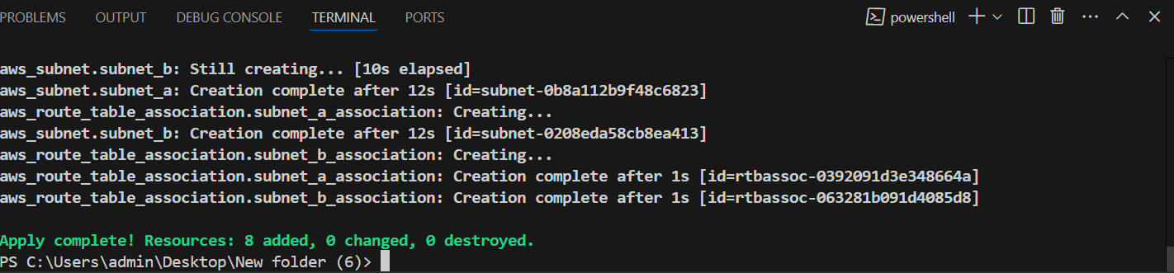
After vpc run this commands in visual studio code:
Terraform plan: The terraform plan command in Terraform previews the changes that Terraform will make to your infrastructure before you apply them.
After Terraform plan changes has been applied its shown below:
After next terraform apply (or) terraform apply –auto-approve use this commands
Terraform apply: In Terraform, the command terraform apply is used to apply the changes defined in the configuration files to the infrastructure. It initiates the process of provisioning or modifying resources in your environment based on the configurations you have written in .tf files.
After terraform apply changes has been applied its shown below:

Slide 27
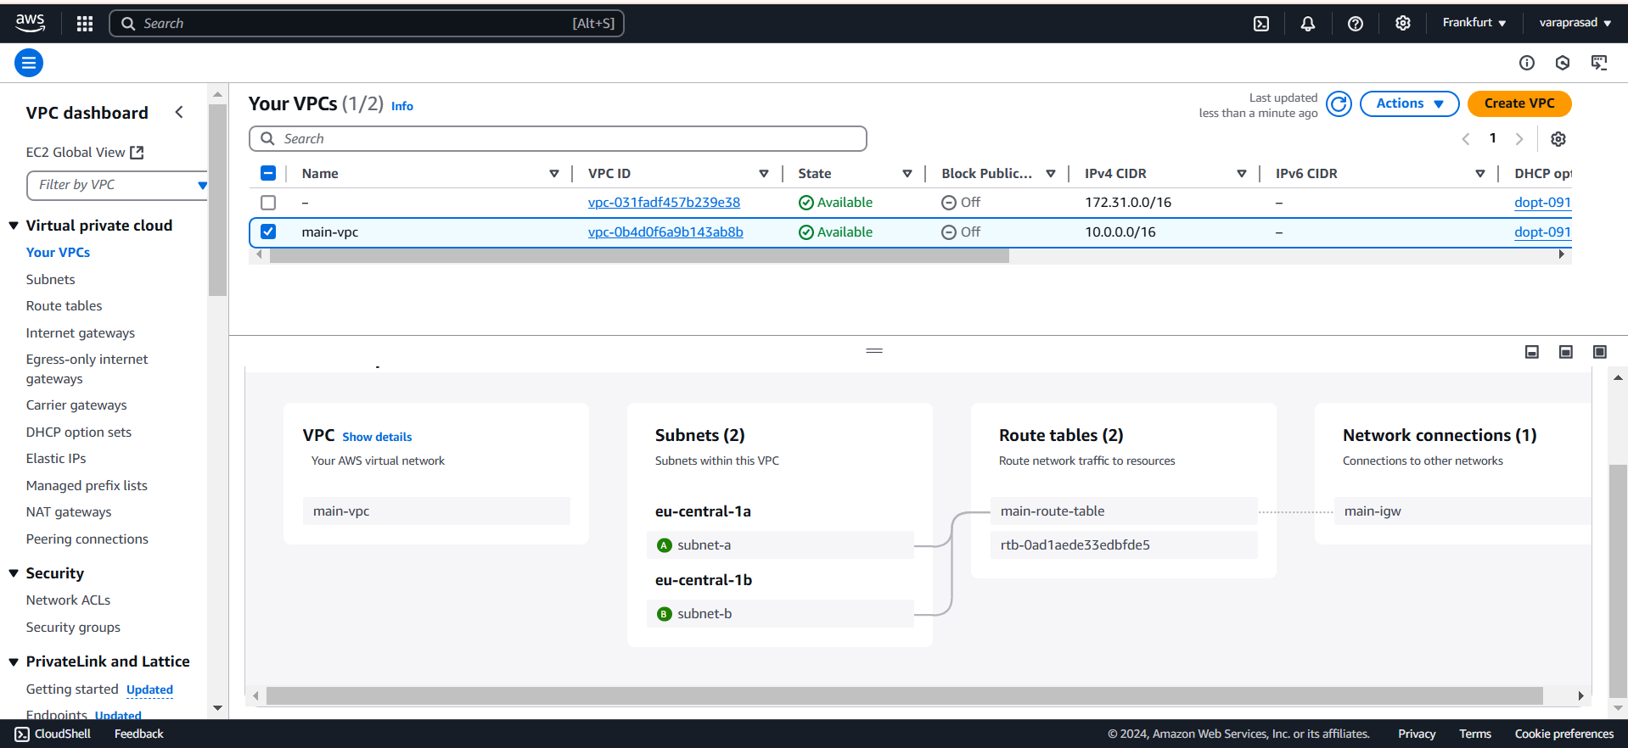
After apply vpcs, subnets,Route tables, internet gateways its shown below:

Slide 28
Security Group:
resource "aws_security_group" "allow_all" {
name = "allow_all_sg"
description = "Allow all inbound and outbound traffic"
vpc_id = aws_vpc.main.id
ingress {
from_port = 0
to_port = 0
protocol = "-1"
cidr_blocks = ["0.0.0.0/0"]
}
egress {
from_port = 0
to_port = 0
protocol = "-1"
cidr_blocks = ["0.0.0.0/0"]
}
}

Slide 29
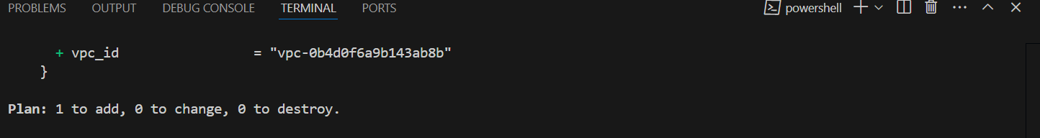
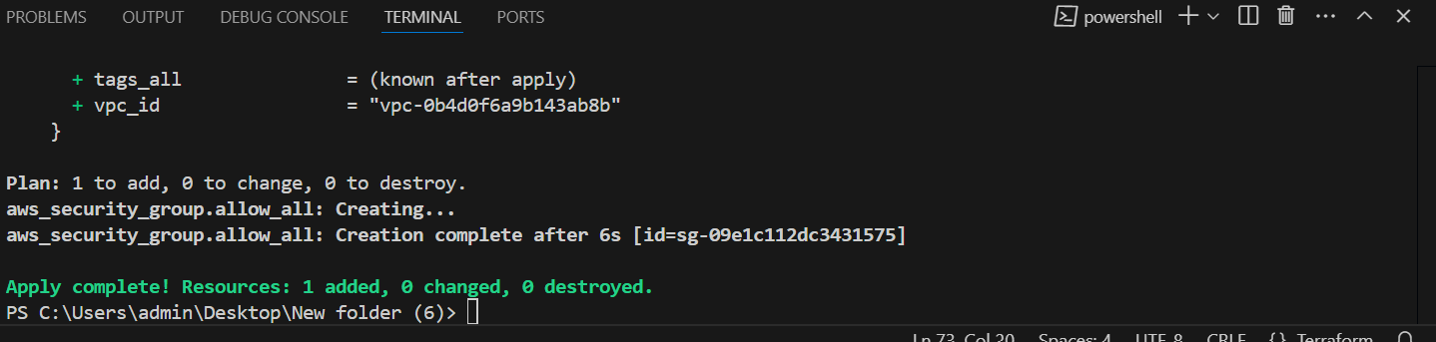
Security Group:
Creates a security group (allow_all_sg) that allows all inbound and outbound traffic (-1 protocol means all traffic). It is applied to the resources in the VPC.
After run this command terraform plan
After plan changes has applied shown below :
After next terraform apply
After apply changes has been applied its shown below :

Slide 30
EC2 Instance:
resource "aws_instance" "example" {
ami = "ami-0b5673b5f6e8f7fa7" # Replace with a valid AMI ID
instance_type = "t2.micro"
subnet_id = aws_subnet.subnet_a.id
security_groups = [aws_security_group.allow_all.id]
associate_public_ip_address = true
tags = {
Name = "example-ec2"
}
}
EC2 Instance: Launches an EC2 instance (example-ec2) with an ami-0b5673b5f6e8f7fa7 (replace with a valid AMI ID), of type t2.micro in subnet_a. It will be assigned a public IP, and the instance will use the allow_all_sg security group to allow all traffic.

Slide 31
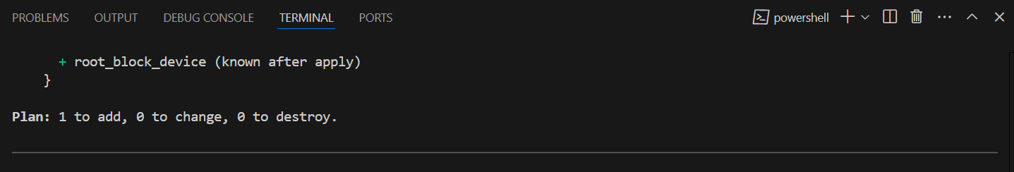
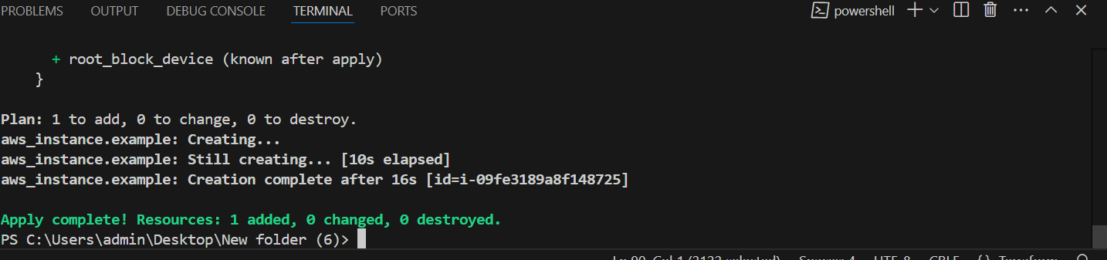
After run terraform plan
After plan changes has been applied its shown below:
And next terraform apply
After apply changes has been applied its shown below:

Slide 32
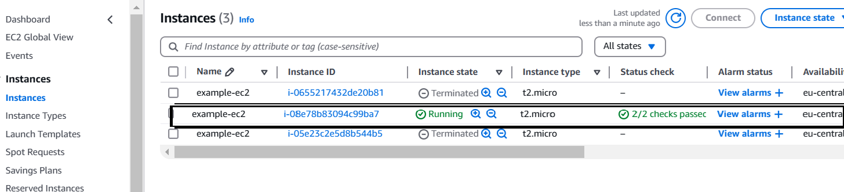
After run finally ec2 instance has been created its shown below:

Slide 33
S3 Bucket
resource "aws_s3_bucket" "example" {
bucket = "my-example-bucket-terraform-1"
acl = "private"
tags = {
Name = "example-s3-bucket1"
}
}
S3 Bucket:
Creates an S3 bucket named my-example-bucket-terraform-1 with private access control. This is a storage resource where files can be stored.
After run terraform plan

Slide 34
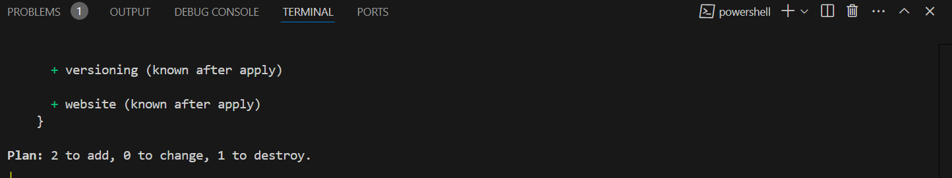
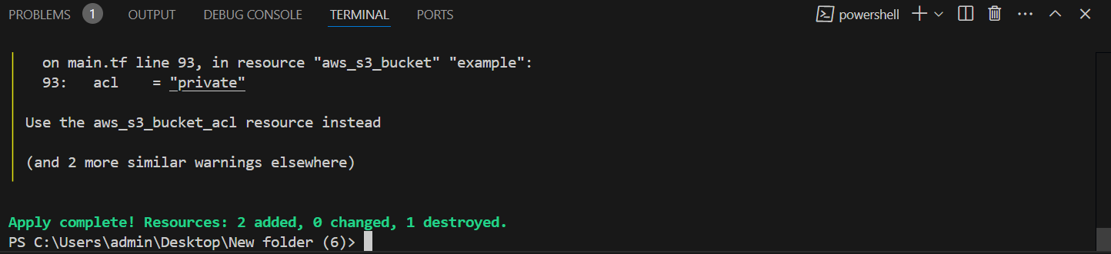
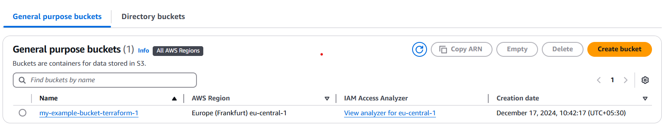
After plan changes has been applied is shown below:
And next terraform apply
And apply changes has been applied its shown below:
And finally bucket has been created its shown below:

Slide 35
RDS Database instance:
resource "aws_db_instance" "default12" {
allocated_storage = 20
storage_type = "gp2"
instance_class = "db.t3.small"
engine = "mysql"
engine_version = "8.0"
identifier = "mydbinstance"
username = "admin"
password = "prasad123" # Replace with a secure password
db_name = "mydatabase"
publicly_accessible = true
vpc_security_group_ids = [aws_security_group.allow_all.id]
db_subnet_group_name = aws_db_subnet_group.default.name
multi_az = false
tags = {
Name = "MyRDSInstance"
}
}

Slide 36
RDS Instance:
Creates a MySQL 8.0 RDS instance (mydbinstance) with 20 GB of allocated storage and a db.t3.small instance type. It is publicly accessible (although in production, you would usually set this to false for security). It uses the allow_all_sg security group and the subnet group aws_db_subnet_group.default.
RDS Subnet Group code:
resource "aws_db_subnet_group" "default" {
name = "default12"
subnet_ids = [aws_subnet.subnet_a.id, aws_subnet.subnet_b.id]
tags = {
Name = "MyDBSubnetGroup"
}
}
DB Subnet Group: Creates a DB subnet group, which includes the two subnets (subnet_a and subnet_b). This ensures the RDS instance is spread across multiple availability zones.

Slide 37
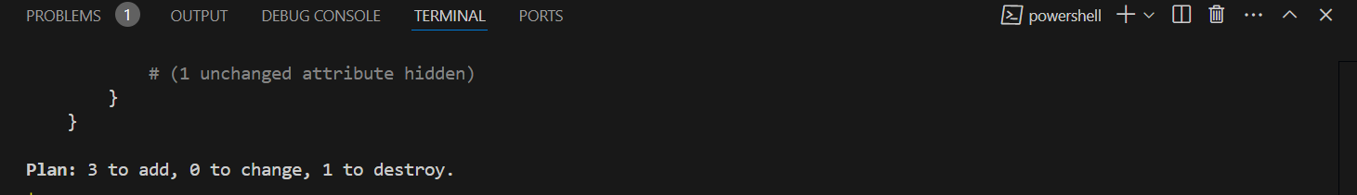
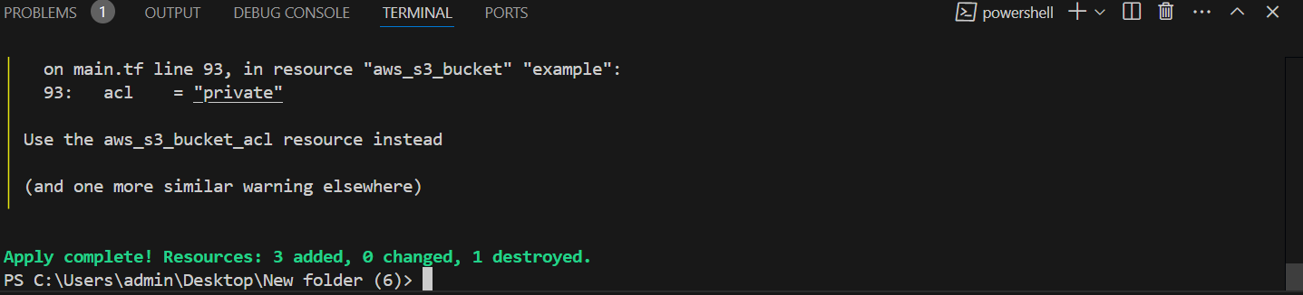
After run terraform plan
After plan changes has been applied its shown below:
And next terraform apply
Run apply changes has been applied its shown below:

Slide 38
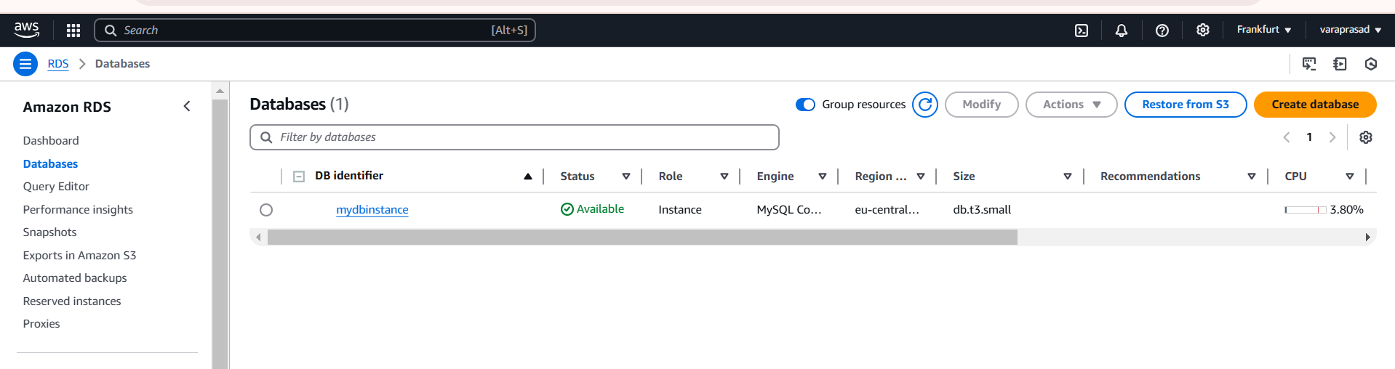
After finally RDS has been created its shown below:

Slide 39
EBS Volume:
resource "aws_ebs_volume" "example" {
availability_zone = "eu-central-1a"
size = 10
type = "gp2"
tags = {
Name = "example-ebs-volume"
}
}
EBS Volume:
Creates a 10 GiB General Purpose SSD (gp2) EBS volume in the eu-central-1a availability zone.

Slide 40
EBS Volume Attachment
resource "aws_volume_attachment" "example" {
device_name = "/dev/sdh"
instance_id = aws_instance.example.id
volume_id = aws_ebs_volume.example.id
}
EBS Volume Attachment:
Attaches the EBS volume (aws_ebs_volume.example) to the EC2 instance (aws_instance.example) at device name /dev/sdh.
After run terraform plan

Slide 41
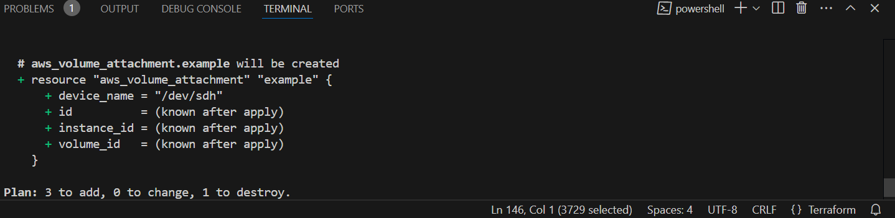
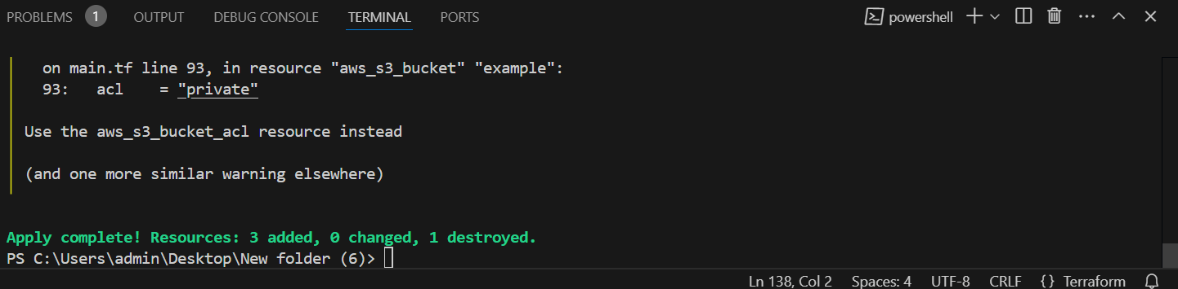
After plan changes has been applied its shown below:
Next terraform apply
After Run apply changes has been applied its shown below:

Slide 42
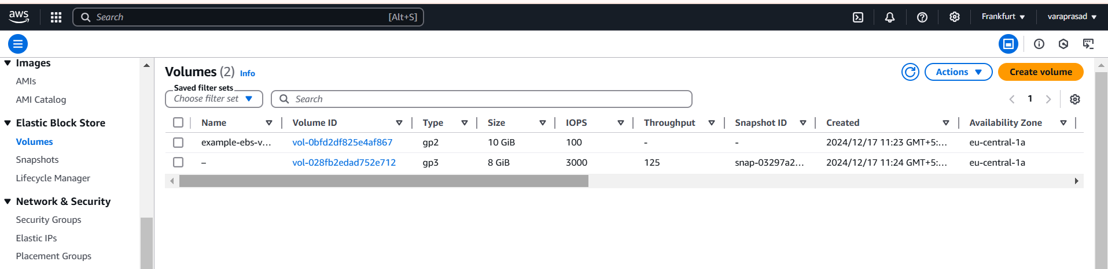
Finally EBS volumes has been created its shown below:

Slide 43
Summary
This Terraform code creates an AWS infrastructure with:
A VPC (10.0.0.0/16) containing two public subnets (subnet_a and subnet_b).
An Internet Gateway to provide internet access to instances in the VPC.
An EC2 instance running in subnet_a, accessible via a public IP.
An S3 bucket for storage.
An RDS MySQL instance with a public endpoint and a subnet group across both subnets.An EBS volume that is attached to the EC2 instance for additional storage.
Each resource is tagged for easier identification and management within the AWS console. Before applying the configuration, make sure to update the AMI ID for the EC2 instance and ensure that sensitive information (like the RDS password) is managed securely.

Slide 44


